Slide 1
Unit 4 Lecture 2

Slide 2
Full-Adder
A full-adder is a combinational circuit that forms the arithmetic sum of three input bits.
It consists of three inputs and two outputs.
Two of the input variables, denoted by x and y, represent the two significant bits to be added.
The third input, z, represents the carry from the previous lower significant position.

Slide 3
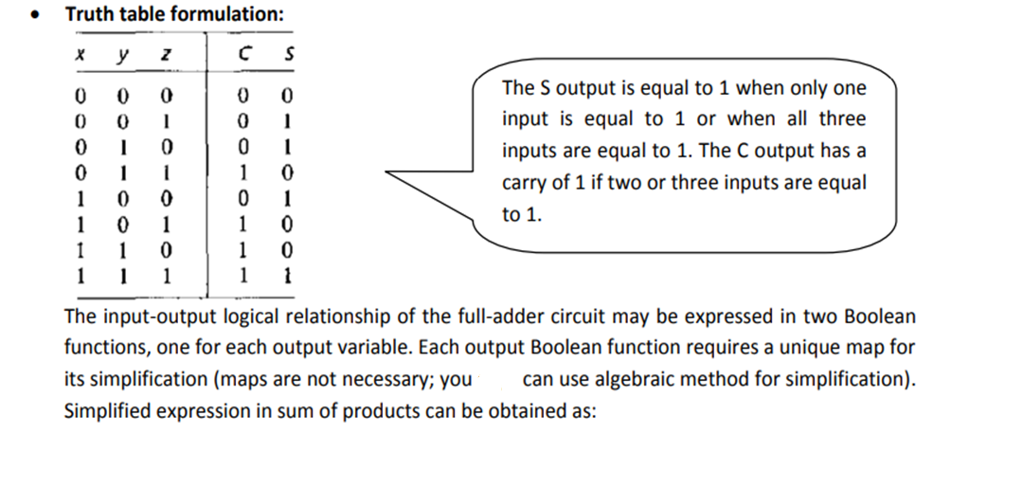

Slide 4
The input-output logical relationship of the full-adder circuit may be expressed in two Boolean functions, one for each output variable.
Each output Boolean function requires a unique map for its simplification (maps are not necessary; you can use algebraic method for simplification).
Simplified expression in sum of products can be obtained as:

Slide 5
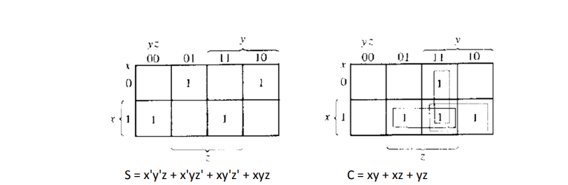

Slide 6
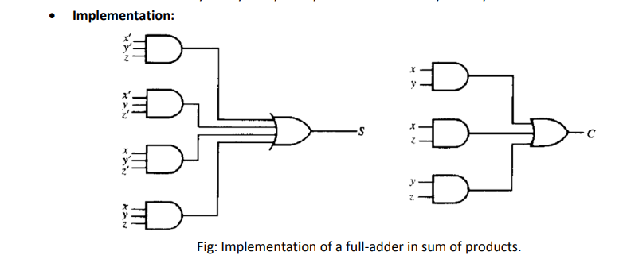

Slide 7
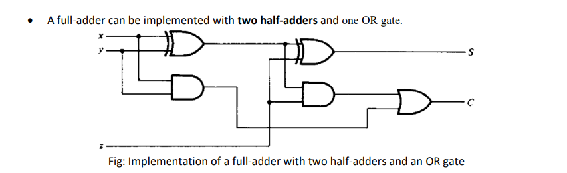

Slide 8
Subtractors :
The subtraction of two binary numbers may be accomplished by taking the complement of the subtrahend and adding it to the minuend.
By this method, the subtraction operation becomes an addition operation requiring full-adders for its machine implementation.
By this method, each subtrahend bit of the number is subtracted from its corresponding significant minuend bit to form a difference bit.
If the minuend bit is smaller than the subtrahend bit, a 1 is borrowed from the next significant position.
Just as there are half- and full-adders, there are half- and full-subtractors.

Slide 9
Half-Subtractor
A half-subtractor is a combinational circuit that subtracts two bits and produces their difference bit.
Denoting minuend bit by x and the subtrahend bit by y.
To perform x - y, we have to check the relative magnitudes of x and y: o If x≥ y, we have three possibilities: 0 - 0 = 0, 1 - 0 = 1, and 1 - 1 = 0.
o If x < y, we have 0 - 1, and it is necessary to borrow a 1 from the next higher stage.
The half-subtractor needs two outputs, difference (D) and borrow (B).

Slide 10
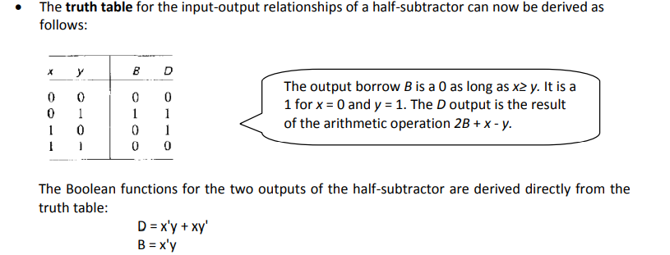

Slide 11
Full-Subtractor :
A full-subtractor is a combinational circuit that performs a subtraction between two bits, taking into account that a 1 may have been borrowed by a lower significant stage.
This circuit has three inputs and two outputs.
The three inputs, x, y, and z, denote the minuend, subtrahend, and previous borrow, respectively.
The two outputs, D and B, represent the difference and output-borrow, respectively.
Truth-table and output-function formulation

Slide 12
